Slide 1
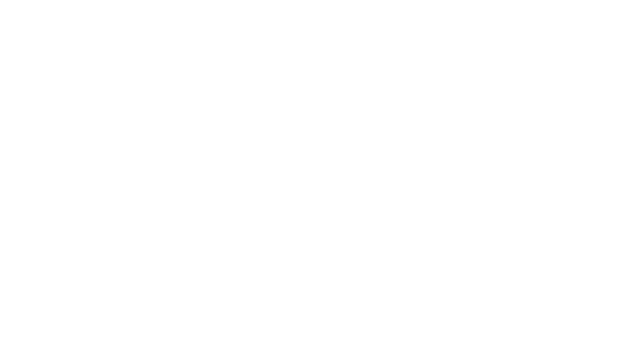


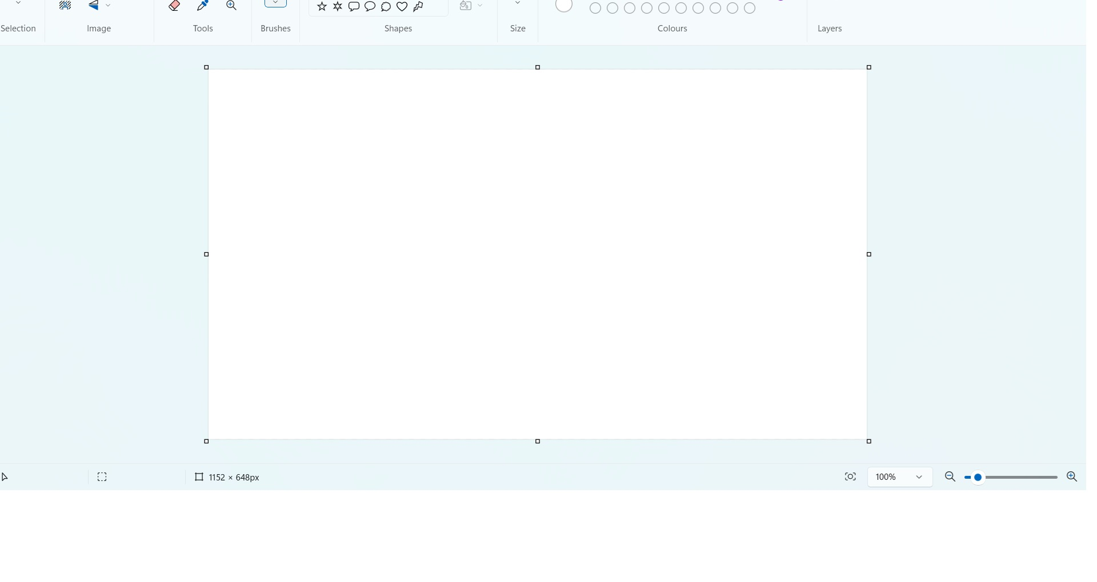
KLE College of Pharmacy
Vidyanagar, Huballi - 580031
(A Constituent unit of KAHER Belagavi,
Deemed-to-be-university) Karnataka.
“FORMULATION AND EVALUATION OF TOPICAL MICROEMULGEL FOR TREATMENT OF MELASMA”
DISSERTATION PRESENTATION
Guided by : Mr. Harish K H
Associte Professor
Department of Pharmaceutics,
KLE College of Pharmacy,
Hubballi
Presented by: Mahima A Mudhole
Dept of Pharmaceutics,
KLE College of Pharmacy,
Hubballi.

Slide 2
INTRODUCTION
Melasma, formerely known as choalasma, is a pigamentary disorder that develops over time and most frequently affects the face. Melasma is a common acquired pigmentary disorder that manifests as a symmertric hyperpigmented macules and patches on the face, more frequently affecting women of reproductive age.
The main causees if this condition, which affects more women and those with darker skin tones, include UV exposure and hamonal factors.
Centrofacial, malar, and mandibular symmetric reticulated hypermelanosis are the three most common facial patterns associated with melasma, it majorily affects mouth, uppper lip, excluding the philtrium, cheeks and chin in the predominant clinical pattern .
There are certain known triggering variables such as sun exposure, pregnancy, sexual hormones, inflammatory skin conditions, usage of cosmetics, steroids, ovarian tumours ,intestinal parasites, hepatopathies hormone replacement therapy and photosensitizing medications.
Melasma causes patients distress since it mostly affects the face, is readily visible, and is always present in daily life. In this situation, it has deterimental effect on patients quality of life, hurting their psychological and emotional health, which frequently prompts them to look for a dermatologists.

Slide 3
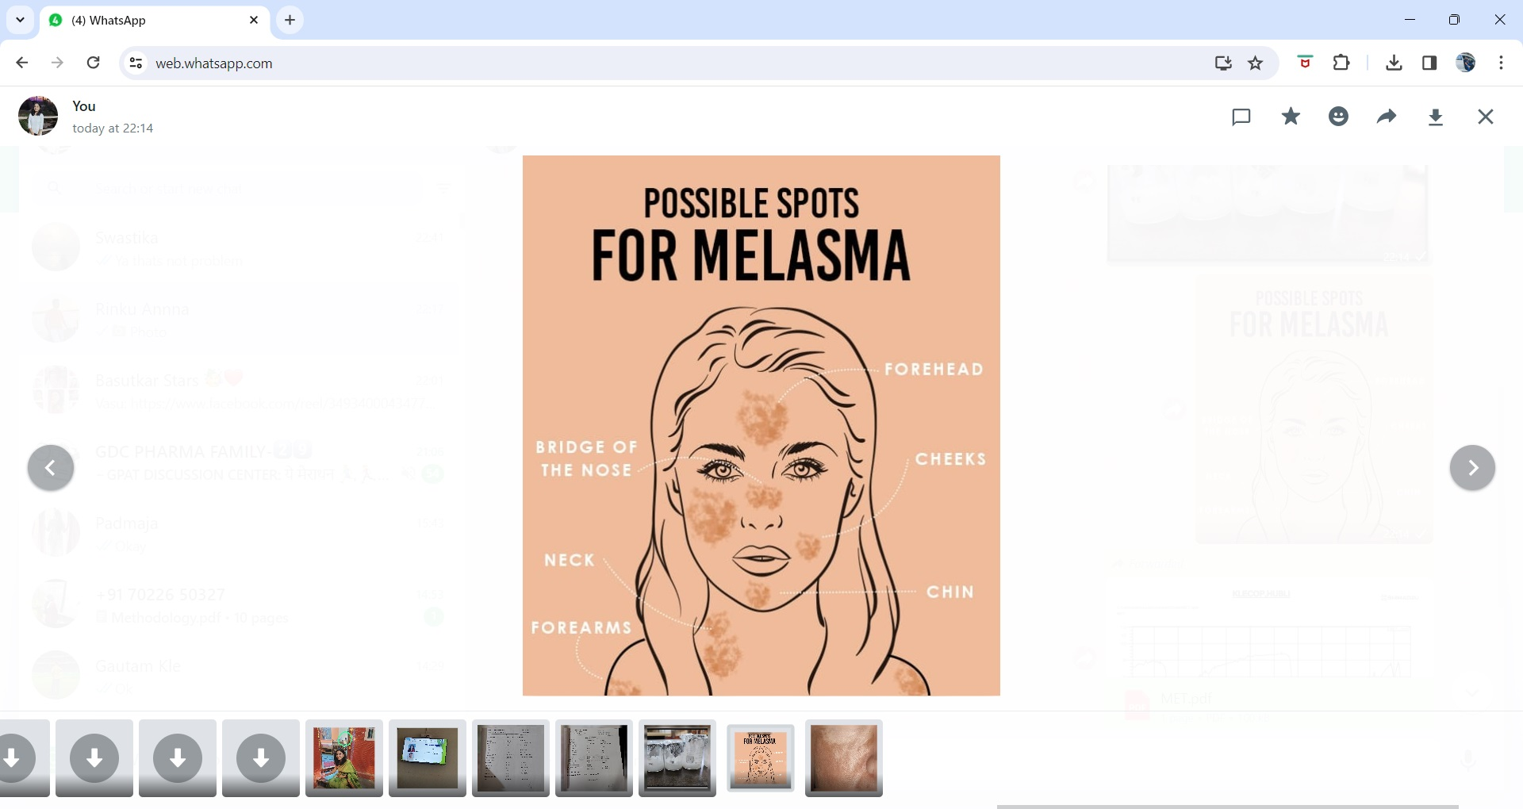
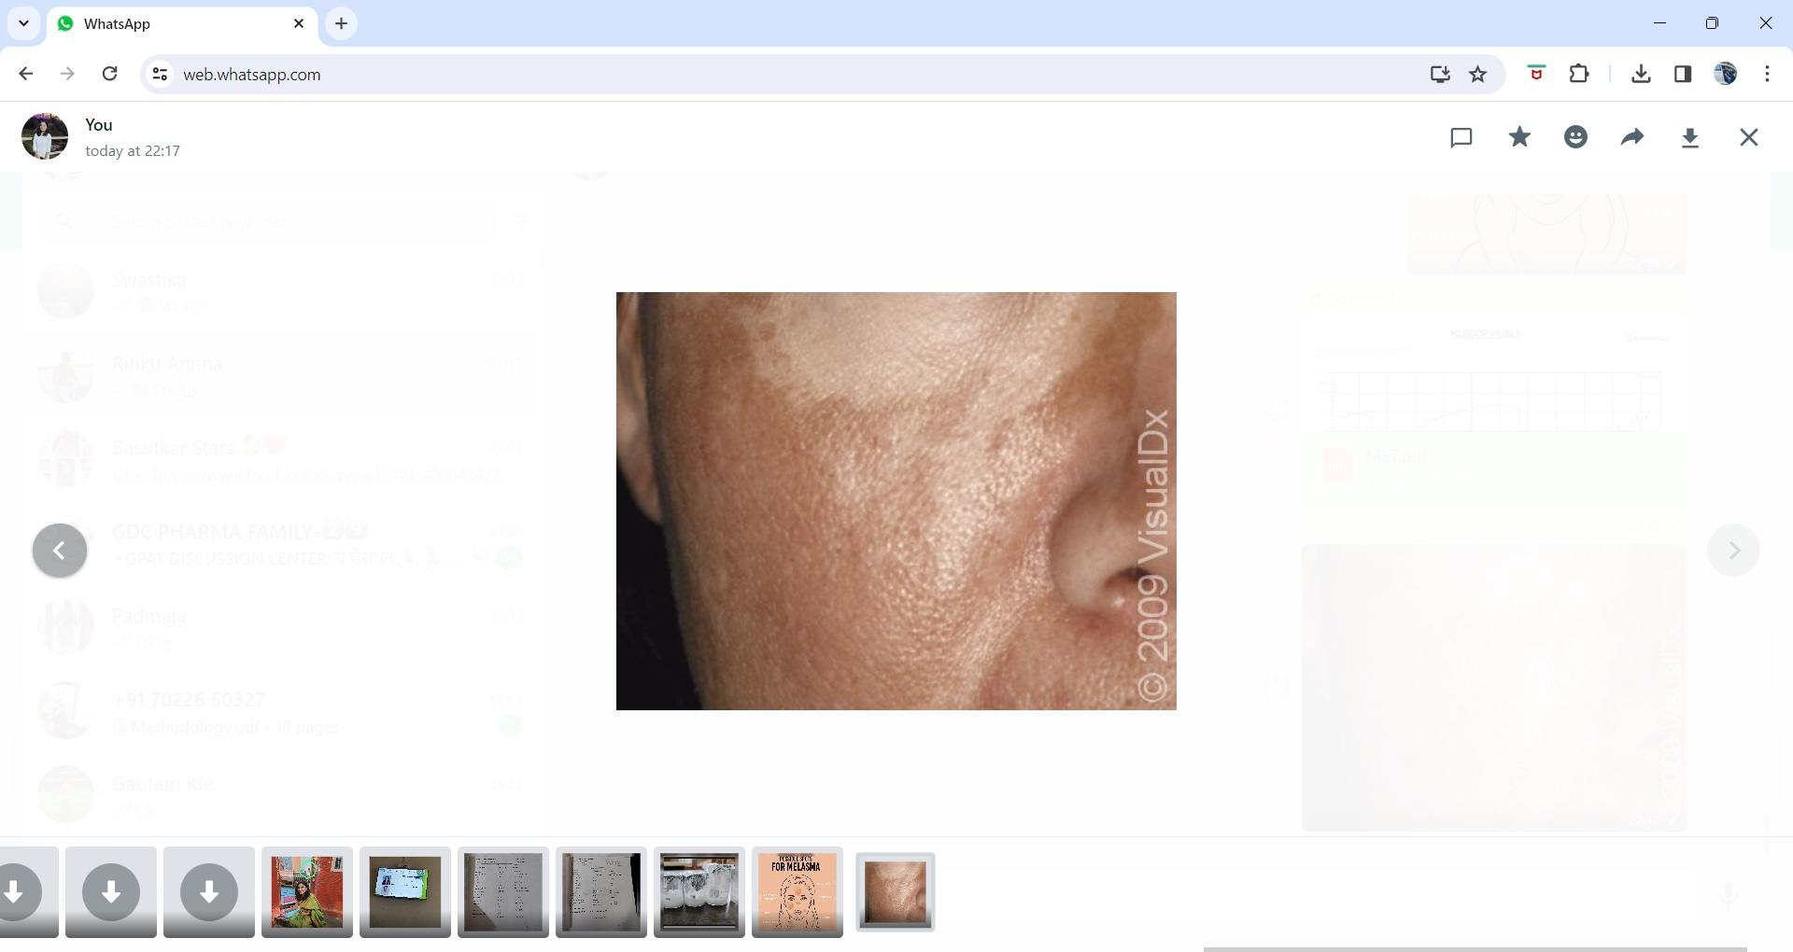
The quest for an ideal treatment which can achieve efficient depigmentation in melasma without any adverse effects has continued .
Recently, in vitro studies have shown that topical metformin has melanopenic action, which is due to downregulation of the expression of MITF { Melanocyte inducing transcription factor } which inturn leads to downregulation of transcription of various melanogenic proteins such as tyrosinase, TRP-1, TRP-2 and protein kinase C-beta.
The study was undertaken to formulate, optimize and evaluate the safety and efficacy of topical metformin in melasmaicroemulsion based gels.
Microemulgel
The micron - sized globules of microemulgel have higher penetration, allowing the medicine to reach systemic circulation directly. This improves both the drugs bioavailability and patient compliance .
The microemulgel for dermatological and cosmetic use has a variety of desirable qualities including good consistency, being thixotropic, easily spreadable, non-staining, emollient, biofriendly, clear, transparent and elegant appearance. Additionally, these microemulgel - based formulations improves the skin deposition of API, ultimately increasing its therapeutic activity.

Slide 4
REVIEW OF LITERATURE
SL NO | TITLLE | JOURNAL | RESULTS
1 | Melasma Treatment An evidence based review. | American journal of clinical dermatalogy. | Melasma is an chronic condition understanding of melasma through further research will potentially gives us new and improved therapies in future.
2 | Melasma an up to date comprehensive review. | American journal of clinical dermatalogy. | Multifactorial etiology of melasma , it is important to have a multimodal therapeutic approach .

Slide 5
REVIEW OF LITERATURE
SL NO | TITTLE | JOURNAL | RESULTS
3 | Microemulgel an overwhelming approach to improve therapeutic action of drug moiety. | Saudi pharmaceutical journal | Selection of oil, emulsifiers and co-emulsifiers for penetration through the skin depends upon skin.
4 | Topical metformin in the treatment of melasma : A preliminary clinical trial. | Journal of cosmetic dermatalogy | In vitro study has shown that metformin , the most commonly used oral hypoglycemic drug , has melanopenic actionwhen applied topically.
5 | Topical metformin : A promising alternative . | Journal of cosmetic dermatalogy | A higher drug bioavailability may be achieved.

Slide 6
NEED FOR THE STUDY
Microemulsions have a broad spectrum of applications in drug targetting and controlled drug release. They have unique distinguishing features like enhanced bioavailability, due to their ability to solubilize lipophillic drugs.
Microemulsions demonstrate greater longevity as compared to other biphasic dosage forms.Microemulsions are designed keeping in mind the utilization of their unique properties like toxic side effects and reduction in the volume of carrying vehicle.
Focusing on the treatment of melasma numerous things like sun exposure heridity and female sex harmones can cause it. Despite the fact that melanocytes alone were once believed to be the main factor, the pathophysiology of melasma is complex.
Melasma significantly affects the one’s appearance, brings on psycho social and emotional anguish and lowers one’s quality of life. Patients frequently describe having low self esteem, anhedonia, a sense of unhappiness and lack of motivation to leave the house.
The precise causes of melasma are unknown .
Therefore, considering the depigmenting potential of metformin on melasma need to be formulated, evaluated in the form of topical microemulgel.

Slide 7
OBJECTIVES
AIM OF THE STUDY
Formulation and evaluation of topical microemulgel by using metformin for treatment of melasma.
The main objective of the present research work is to ,
To formulate and optimize the microemulsion based gels for topical application by using metformin.
To evaluate the microemulsion based gels.

Slide 8
MATERIALS
MATERIALS USED
API : Metformin HCL
OIL : Linseed oil, lemon oil .
SURFACTANT : Tween 80, span 20, span 80 .
CO SURFACTANT : Polyethylene glycol, propylene glycol .
GELLING AGENT : HPMC.
HUMECTANT : Glycerine
VEHICLES : Distilled water.
OTHER PRESERVATIVES : Preservatives and fragnance.

Slide 9
METHODOLOGY
Identification of API
Scanning and Caliberation curve of API in solvent and in phosphate buffer at specific pH.
Identification of excipients.
Short listing oils that have no interference of absorbance of API. [ Generally between 200 to 400 nm ]
Screening of oil among the shortlisted oils, emulsifier, and co-emulsifier on the basis of solubility study.
Selection of emulsifier, co-emulsifier, its ratio and oil .
API - Excipients compatibility study.
Formulation of microemulsion : By phase titration method for preparation of Pseudo ternary diagram.
Formulation of gel base for microemulsion.
Preparation of API loaded micro - emulsion.
Incorporation of prepared microemulsion in to gel with continous stirring to form microemulsion based gel.
Optimization of microemulsion.
Formulation and development of API loaded microemulgel using suitable design of expereinments.
EVALUATION PARAMETERS.

Slide 10
SATURATION SOLUBILITY OF DRUG,SURFCTANTSAND COSURFACTANTS
Various natuarally occuring oils and synthetic oils were analyzed for metformin solubility to find out the best suitable oil for construction of pseudo ternary phase diagrams. To determine the ingredients needed to create microemulsions, the solubility of various surfactants and co-surfactants was also investigated.
An excess amount of metformin HCL[400mg] was placd in stoppered capped vials containing 3ml of vehicle thats is oil [linseed oil],surfactant[Span 20,tween 80] and co-surfactant[PEG,PG] with the vehicles. Then vials vials were shaken using a mechanical rotary shaker for 72hrs at 37⁰C. After attaining equilibrium conditions, the vials were centrifuged at 5000rpm for 15min, using centrifuge to obyain a clear supernatant liquid.Then the supernatant was collected and extracted for metformin using methanol and appropriately diluted. The extracted materials wee examined using a UV spectrophotometer at 249nm after being filtered via a 0.45micro meter filter.

Slide 11
SOLUBILITIES STUDIES
DATA OBTAINED
PHASE TYPE | EXCIPIENT | SOLUBILITY [mg/ml]
Oil | linseed oil | 0.64
Surfactant | Span 20 | 16.4
 | Tween 80 | 23.8
Co-surfactant | PG | 10.2
 | PEG 400 | 12.7

Slide 12
DEVELOPMENT OF PSEUDO TERNARY DIAGRAM BY USING PHASE TITRATION METHOD
Linseed oil, lemon oil and olive oil was selected as oil phase from solubilities studies.Tween 80 and polyethylene glycol was selected as surfactant and co-surfacrtant respectively.Tween 80 was selected also on the basis of HLB value which is 15 and suitable for o/w formulation.
Surfactant and Co-surfactant were mixed [Smix] in 1:2,2:1,3:1 and 4:1 ratios. For each phase diagram, oil and Smix at specific ratio were mixed thoroughly in vortex mixer to give oil : Smix at different ratio from 9:1 to 1:9 ratio.
Each mixture was titrated with water and visual observation was made transparent o/w microemulsion.
End point for the titration was turbid appearance of mixture.
From findings of water titration method pseudoternary phase diagram was constructed with one axis representing aqueous phase, oil and surfactant and co-surfactant.

Slide 13
OIL : Smix[9:1-1:9] | Smix %[in ratio] | Water [ Solvent ]
0.1 + 1 | 0.5 + 0.5 | 1.4
0.2 + 0.99 | 0.66 + 0.33 | 2.1
0.3 + 1 | 0.75 + 0.25 | 2.5
0.4 + 1 | 0.8 + 0.2 | 2.7
0.5 + 0.99 | 0.83 + 0.16 | 3.4
0.6 + 0.99 | 0.85 + 0.14 | 4.0
0.7 + 0.99 | 0.87 + 0.12 | 5.0
0.8 + 0.99 | 0.88 + 0.11 | 5.3
0.9 + 1 | 0.9 + 0.1 | 5.7

Slide 14
FORMULATION OF MICROEMULSION BASED GEL
EMULSION
Linseed oil + tween 80 + span 20 + water [ 3:2:1ratio ]
HPMC + Water [ soaked overnight ]
GEL BASE
Mixed in 1:1 ratio
Glycerine , sodium benzoate and water is added to above mixture
Mixture is mixed evenly by using ultra stirrer

Slide 15
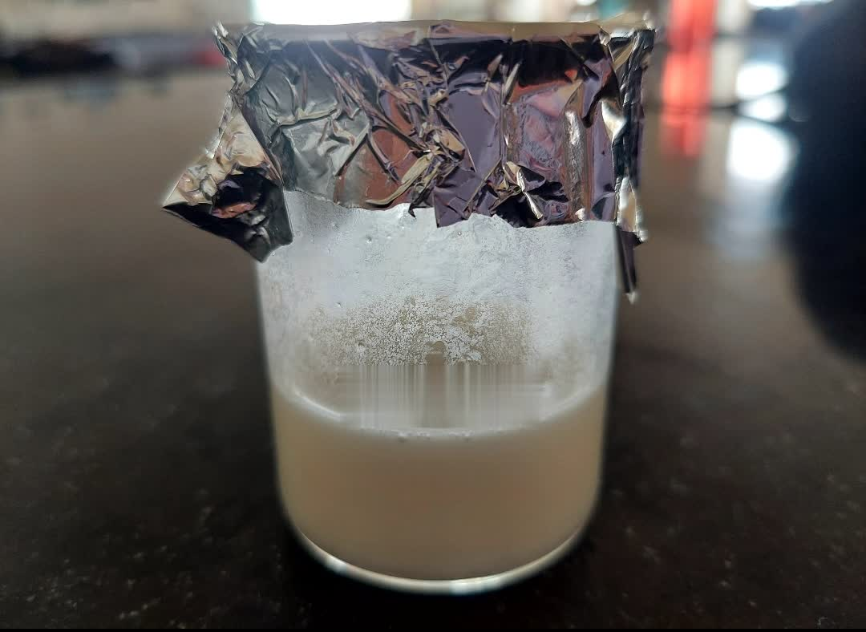
FORMULATION TABLE OF PLACEBO
SL NO | INGREDIENTS | QUANTITY | FUNCTIONS
1 | HPMC | 0.75 g | Gelling agent
2 | LINSEED OIL | 10 ml | Oil
3 | TWEEN 80 | 1.7 ml | Emulsifier
4 | SPAN 20 | 1.7 ml | Emulsifier
5 | GLYCERINE | 5 ml | Humectant
6 | SODIUM BENZOATE | 0.6 g | Preservative
7 | WATER | qs | Vehicle

Slide 16
FORMULATION FOR METFORMIN MICROEMULGEL
INGREDIENTS | F1 | F2 | F3 | F4 | F5
Metformin | 1g | 1g | 1g | 1g | 1g
HPMC | 2% | 4% | 6% | 2% | 4%
Linseed oil | 5 | 5 | 5 | 5 | 5
Tween 80 | 0.25 | 0.25 | 0.25 | 0.4 | 0.4
Span 20 | 1 | 1 | 1 | 0.85 | 0.85
Distilled water | qs | qs | qs | qs | qs
PHYSICAL EVALUATION
Colour - white
Odour - Pleasant
Texture - smooth
State - Semi solid

Slide 17
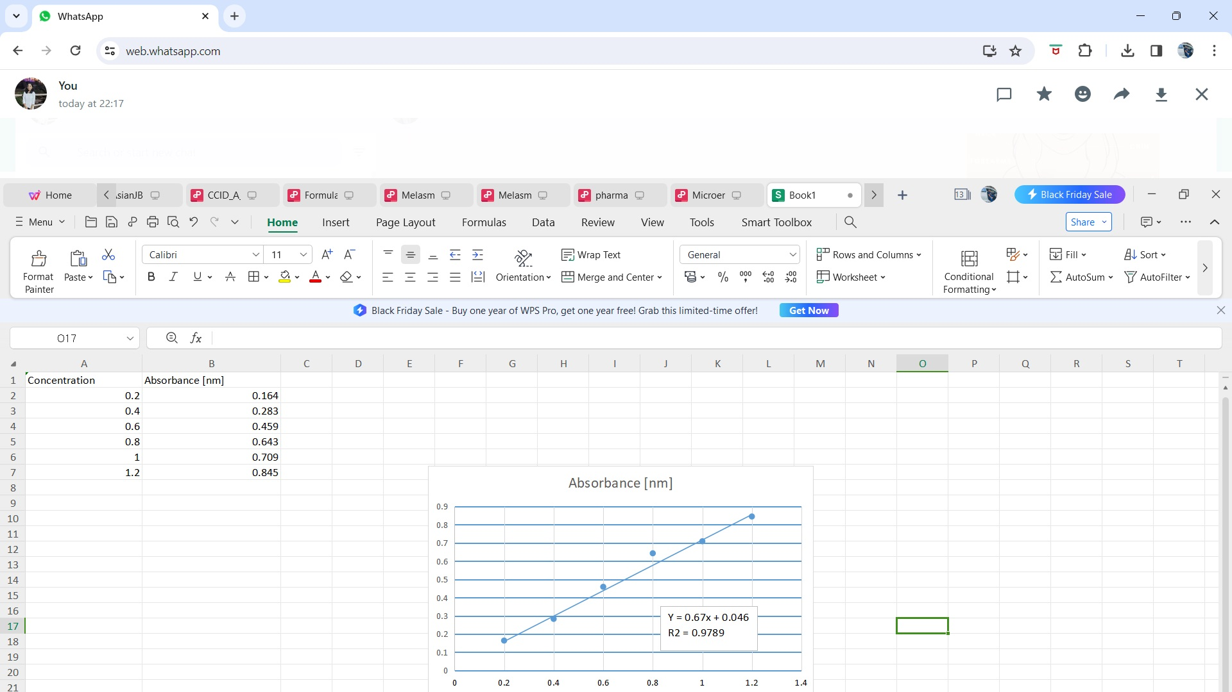
UV Estimation of metformin
SL NO | Concentration | Absorbance [nm]
1 | 0.2 | 0.164
2 | 0.4 | 0.283
3 | 0.6 | 0.459
4 | 0.8 | 0.643
5 | 1 | 0.709
6 | 1.2 | 0.845
Calibration curve of metformin at 234nm

Slide 18
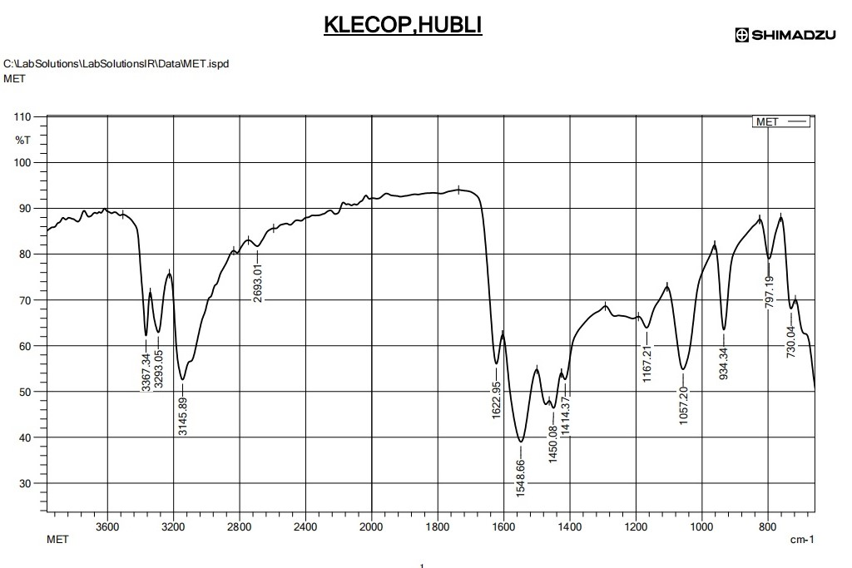
FTIR OF METFORMIN
Wavenumber (cm⁻¹) | Functional Group or Bond
3200-3600 | O-H stretching (alcohol)
3100-3000 | C-H stretching (alkanes)
1700-1600 | C=O stretching (carbonyl)
1560-1500 | N-H bending (amines)
1450 | C-H bending (methylene)
1250-1100 | C-N stretching (amines)
1000-900 | C-O stretching (alcohol or ether)
850-750 | C-H bending (aromatic)

Slide 19
FUTURE WORK PLANS
Evaluation of Placebo
Compactibility studies between drug and excipients
Differential scanning calorimetry [DSC]
Preparation and evaluation of more formulation
Experimental design and optimization
Charaterisation of the prepared microemulsion gel includes the determination of:
Physical Appearance
pH
Viscosity
Percentage of drug content
In - vitro permeation study
Stability study as per ICH guidelines

Slide 20
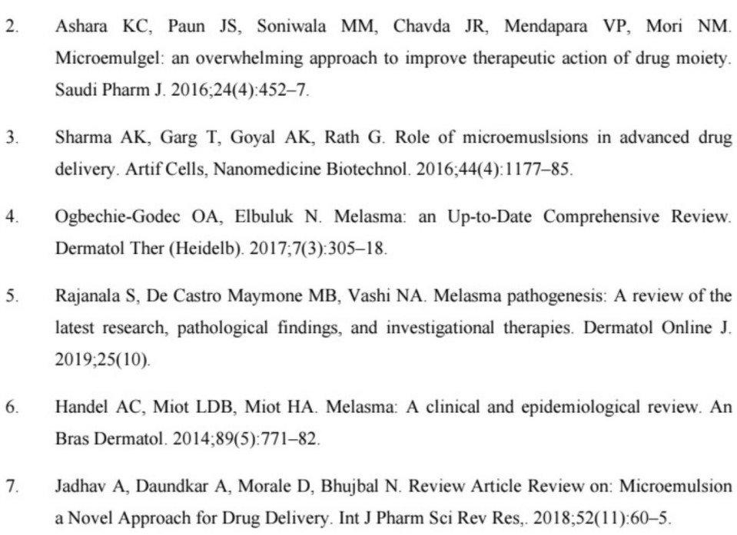
REFERENCES

Slide 21
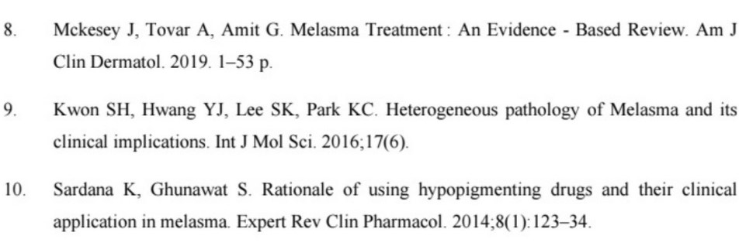

Slide 22
DURATION / ACTIVITY | JUL | AUG | SEP | OCT | NOV | DEC | JAN | FEB | MAR | APRIL
SEMESTER 3
Literature search
Protocol submission
Drug and excipients procurement
Extraction and analytical techniques
Placebo and Pre-formulation studies
Journal club 1st presentation & Biostatistics 1st internal
Microbial studies
1st dissertation protocol presentation
Trial batch formulation and optimization
Journal club 2nd presentation
Biostatistics 2nd sessional
Characterization studies
2nd dissertation protocol presentation
Biostatistics theory examination
Journal club 3rd presentation
Final dissertation protocol presentation
SEMESTER 4
Journal club presentation 1st,2nd & 3rd
Stability test
Thesis writing
Publication
Final project viva

Slide 23
THANK YOU

